Slide 1
External memory merge-sort
This one is not required for the exam!

Slide 2
Overview over this video
This video (which is not required for the exam), we will cover external memory merge sort

Slide 3

Reminder: Computing $σ$_{condition}(R)
Basic procedure:
Needs to read the entire relation
Yes, sometimes!
R:
for each tuple t in R:
tuple 1
tuple 2
if t satisfies condition:
tuple 3
tuple 4
output t
…
Can this be done faster?

Slide 4

Example
Students
$σ$_{programme=‘G401’}(Students)
id | name | programme
… | … | ….
1234 | Anna | G401
2345 | Ben | G701
3456 | Chloe | G401
4567 | Dave | G401
… | … | …
Selection can be performed faster if we know where to find the rows for ‘G401’
Two solutions: sorting & index
This video

Slide 5





Faster Joins With Sorting (from video “Faster Joins With Sorting”)
Sort Join Algorithm:
Typical running time: $O$(|R|log₂|R| $+$ |S|log₂|S|)
If not “too many” values in A occur multiple times
E.g., this is the case if A is a key
Typically much faster than Nested Loop Join
Same time in the worst case, because output can have size up to |R| $×$ |S|
Compute R $⋈$_{A=B} S:
Running time: $O$(|R| $×$ log₂ |R|)
1. Sort R on A
Want to do that faster!
2. Sort S on B
Running time: $O$(|S| $×$ log₂ |S|)
3. Merge the sorted R and S
Running time: $O$(size of output)
Having a run time depending on the size of output is called output sensitive

Slide 6
Outside databases
Many problems are much easier then the data is sorted and in general, a significant fraction of all computing time is spend on sorting
Was estimated to be around 25% back in the 60s
Found some claims that it is still in the range 25%-50%, but it is hard to verify
Some problems were you need sorting are “small” in that they fit in main memory
Some ain’t

Slide 7
Understanding the issue solved
To find one record on hard disk (with very fast “normal” drive of 15,000 rpm):
2.00 milli-seconds or 2.10⁶ nano-seconds
To find one record on SSD:
0.031 milli-seconds or 3.1.10⁴ nano-seconds
To find one record in RAM (with relative normal DDR4-2666 RAM):
13 nano-seconds
SLOW!!!
slow
fast

Slide 8
Merge Sort
(Internal memory) merge sort:
Divide input in two parts P₁, P₂
Sort P₁ & P₂ recursively
While P₁ or P₂ is not empty:
Add smallest remaining element from P₁ or P₂
to output
Merge

Slide 9
External Merge Sort
Number of disk blocks that fit in RAM
External merge sort:
Divide input in M parts P₁, P₂, …, P_{M}
Sort P₁, P₂, …, P_{M} recursively
While not all P_{i} are empty:
Add smallest remaining element from any part P_{i} to output
Merge

Slide 10
Merge in more details
Goal: Must merge M (perhaps large) parts into one
P₁:
P₂:
P_{M}:
Output:
Colors:
Blue in RAM
Orange in disk
White does not exists yet
RAM holds smallest blocks from each part
…

Slide 11
Merge in more details
Fetch following block of first block to finish
1. Move to disk, …
Goal: Must merge M (perhaps large) parts into one
1. Move to disk, …
Colors:
Blue in RAM
Orange in disk
White does not exists yet
RAM holds smallest blocks from each part
…
Fetch following block of first block to finish
Start next output block, …
Start next output block, …
The one with smallest last record

Slide 12
Analysis of External Merge Sort
We split in M buckets in each level of recursion until reminder is below MB (where it fits in RAM and can be sorted directly): log_{M}(N/(MB)) levels
External merge sort:
Divide input in M parts P₁, P₂, …, P_{M}
Sort P₁, P₂, …, P_{M} recursively
While not all P_{i} are empty:
Add smallest remaining element from any part P_{i} to output
Total disk operations: O(N/B log_{M}(N/(MB)))
Merge
On each level of recursion we scan through all blocks once = O(N/B) disk operations, where B is block size

Slide 13
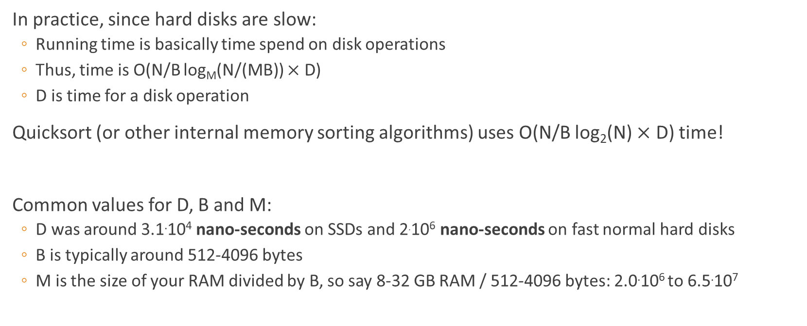
Comparison
In practice, since hard disks are slow:
Running time is basically time spend on disk operations
Thus, time is O(N/B log_{M}(N/(MB)) $×$ D)
D is time for a disk operation
Quicksort (or other internal memory sorting algorithms) uses O(N/B log₂(N) $×$ D) time!
Common values for D, B and M:
D was around 3.1.10⁴ nano-seconds on SSDs and 2.10⁶ nano-seconds on fast normal hard disks
B is typically around 512-4096 bytes
M is the size of your RAM divided by B, so say 8-32 GB RAM / 512-4096 bytes: 2.0.10⁶ to 6.5.10⁷

Slide 14
Numeric example
Want to sort N=4 TB in 4 MB of RAM with B=4096
External Merge Sort:
M = 4 MB/4096 = 1024
log_{M}(N/(M B)) is then ≈ log₁₀₂₄ (1024²) = 2
We are thus using 2 recursive calls, for 3 scans in total
(Internal) Quick Sort:
log₂(N)=42
We are thus using 42 recursive calls, for 43 scans in total
If we used a normal amount of RAM, we would be done in 1 recursive call…
Assuming we are lucky about pivot elements

Slide 15
Summary
External memory sorting is very much faster on inputs that are much larger than main memory

